Slide 1
Employee Data Analysis using Excel
STUDENT NAME: Devisri. G
REGISTER NO: 312209823
NM ID: 152FB81F020871EB4574D18B17514DF5
DEPARTMENT: Bcom Accounting and finance
COLLEGE: Valliammal college for women

Slide 2
PROJECT TITLE
Employee SalaryAnalysis using Excel

Slide 3


AGENDA
Problem Statement
Project Overview
End Users
Our Solution and Proposition
Dataset Description
Modelling Approach
Results and Discussion
Conclusion
3/21/2024 Annual Review

Slide 4

PROBLEM STATEMENT
The Companies Salary Data is Not Being Accurately Tracked And analysed, Leading To Poor Decision Making.

Slide 5

PROJECT OVERVIEW
.
Cleaned And Analyzed Salary Data.
Reports And Visualization Highlighting Trends Disparities.
Recommendations For Optimizing Salary Structures And Budget
Presentation Summarizing Findings And Recommendation.

Slide 6

WHO ARE THE END USERS?
HR Department .
Management Teams.
Finance Department .
Department Heads .
Employee

Slide 7

OUR SOLUTION AND ITS VALUE PROPOSITION
Fair And Transparent Salary Practices.
Data Driven Decision Making.
Optimized Salary Budget.
Improved Compliance.

Slide 8
Dataset Description
Name
Department
Job Title
Hire Date
Salary
Performance
Gender
Age
Tenure
Location
Job Category
Education leave
Certifications

Slide 9

THE "WOW" IN OUR SOLUTION
AI Powered Insights.
Predictive Analytics.
Automatic Reporting.
Real Time Alerts And Notifications.
Interactive Visualizations.
3/21/2024 Annual Review
9

Slide 10
MODELLING
Linear Regression.
Decision Trees.
Clustering.
Correlation Analysis.
Neural Networks.
Survival Analysis.
10

Slide 11
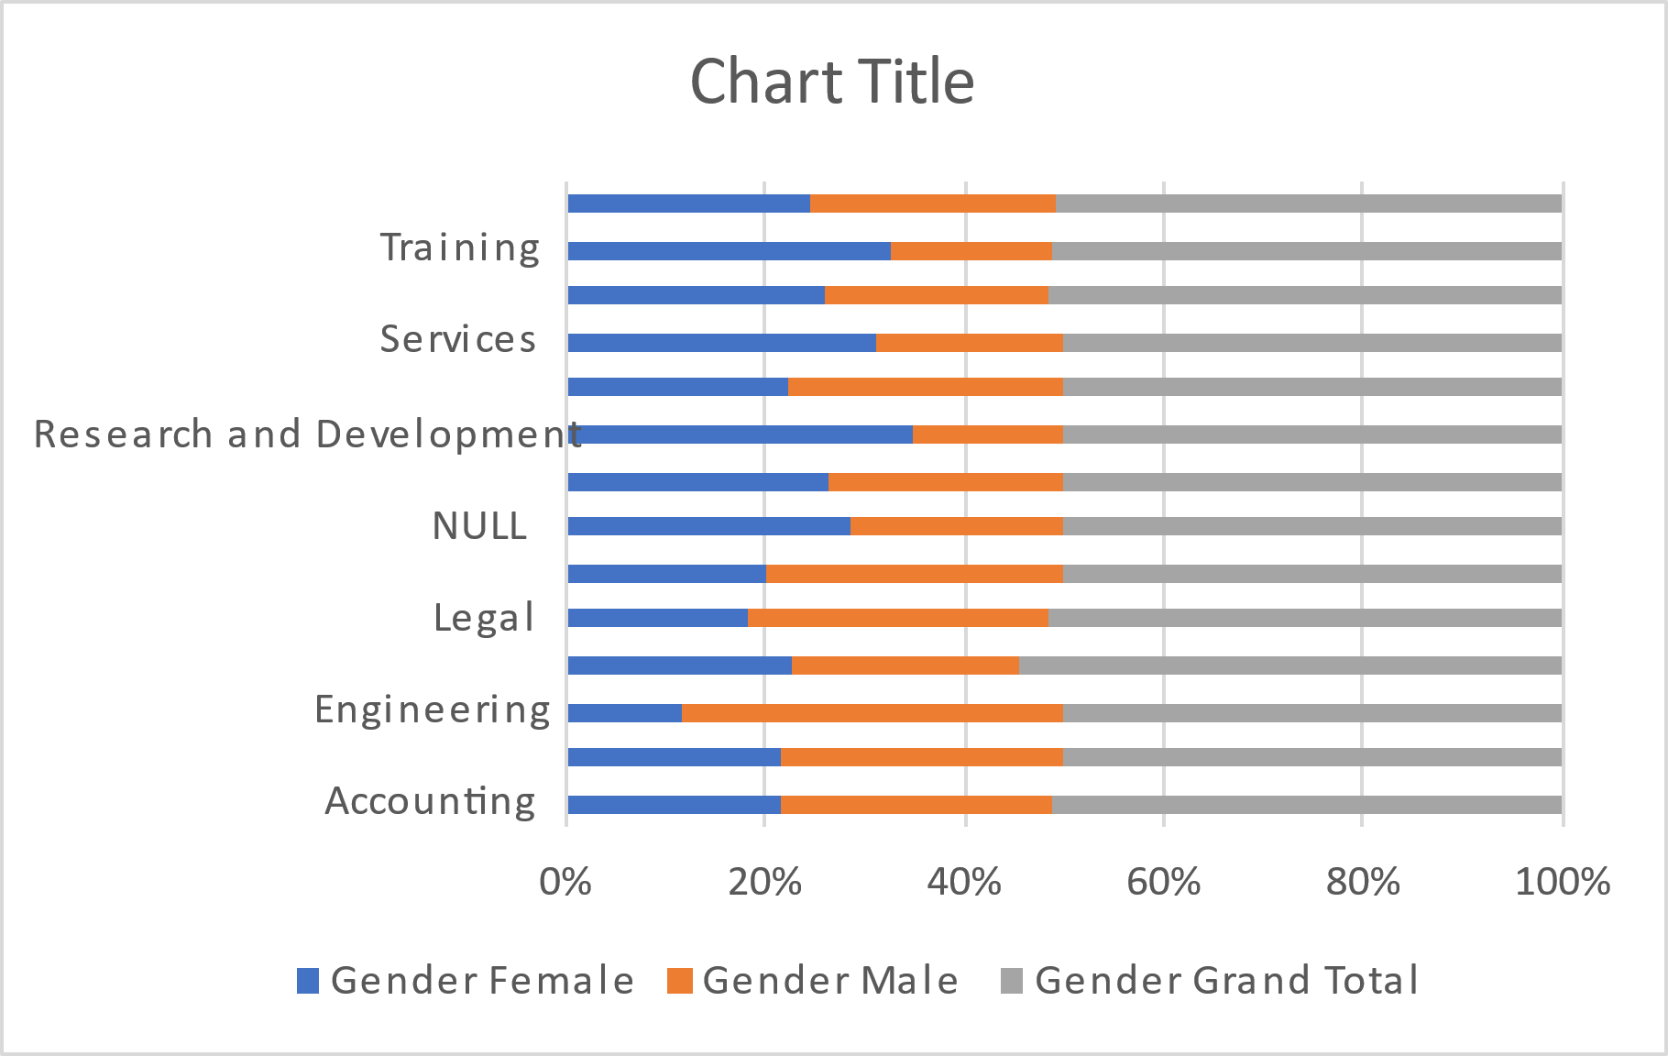
RESULTS
11

Slide 12
conclusion
The Employee Salary Analysis Project Has Provided Valuable Insights Into Our Organisation’s Salary Practices, Revealing Areas Of Disparity, Inefficiency, And Opportunity. By Leveraging Data Analytics And Modelling.

